Slide 1
Chapter-11
Basic Elements of Organizing
11–<number>

Slide 2

The Elements of Organizing
Organizing
  Deciding how to best group organizational activities and resources.
Organization Structure
  The set of building blocks
  that can be used to
  configure an organization.
11–<number>

Slide 3
Designing Jobs
Job Design
  The determination of an individual’s work-related responsibilities.
Job Specialization (Division of Labor)
  The degree to which the overall task of the organization is broken down and divided into smaller component parts.
  Benefits of Specialization
    Workers can become proficient at a task.
    Transfer time between tasks is decreased.
    Specialized equipment can be more easily developed.
    Employee replacement becomes easier.
  Limitations of Specialization
    Employee boredom and dissatisfaction with mundane tasks.
    Anticipated benefits do not always occur.
11–<number>

Slide 4
Adam Smith’s Example of Job Specialization
Making a pin (nail) requires 18 tasks
1 worker doing all 18 tasks might make
20 pins (nails) a day.
20 workers = (20 x 20) = 400 pins
______________________________
With specialization:
20 workers make 100,000 pins a day.
1 worker = 5,000 pins
20 pins vs. 5,000 pins per worker
11–<number>
Notes:
10

Slide 5
Alternatives to Specialization
Job Rotation
  Systematically moving employees from one job to another in an attempt to reduce employee boredom. Most frequent use today is as a training device for skills and flexibility.
Job Enlargement
  An increase in the total number of tasks workers perform.
  Increases training costs, unions contend that workers deserve more pay for doing more tasks, and the work may still be dull and routine.
Job Enrichment
  Increasing both the number of tasks the worker does and the control the worker has over the job.
11–<number>

Slide 6
Alternatives to Specialization (cont’d)
Job Characteristics Approach
  Core Dimensions
    Skill variety—the number of tasks a person does in a job.
    Task identity—the extent to which the worker does a complete or identifiable portion of the total job.
    Task significance—the perceived importance of the task.
    Autonomy—the degree of control the worker has over how the work is performed.
    Feedback— the extent to which the worker knows how well the job is being performed.
  Work Teams
    An alternative to job specialization that allows the entire group to design the work system it will use to perform an interrelated set of tasks.
11–<number>

Slide 7

Grouping Jobs: Departmentalization
Departmentalization
  The process of grouping jobs according to some logical arrangement.
Rationale for Departmentalization
  Organizational growth exceeds
  the owner-manager’s capacity
  to personally supervise all of
  the organization.
  Additional managers are
  employed and assigned
  specific employees to supervise.
11–<number>

Slide 8
Common Bases of Departmentalization
Functional Departmentalization
  Is the grouping of jobs involving the same or similar activities.
Product Departmentalization
  The grouping of activities around products or product groups.
Customer Departmentalization
  Grouping activities to respond to and interact with specific customers and customer groups.
Location Departmentalization
  The grouping of jobs on the basis of defined geographic sites or areas.
11–<number>

Slide 9
Bases for Departmentalization: Apex Computers
President
Computers
Software
Manufacturing
Finance
Marketing
Marketing
Finance
Design
Dallas
Phoenix
Chicago
St. Louis
Industrial sales
Consumer sales
Northwest U.S.
Southwest U.S.
Central U.S.
Southeast U.S.
Northeast U.S.
Figure 11.2
11–<number>

Slide 10
Establishing Reporting Relationships
Chain of Command
  A clear and distinct line of authority among the positions in an organization.
  Unity of Command
    Each person within an organization must have a clear
    reporting relationship to one and only one boss.
  Scalar Principle
    A clear and unbroken line of authority
    must extend from the bottom to the
    top of the organization.
Narrow Versus Wide Spans
  Span of Management
    The number of people who report to a particular manager.
    Sometimes called the span of control.
11–<number>

Slide 11
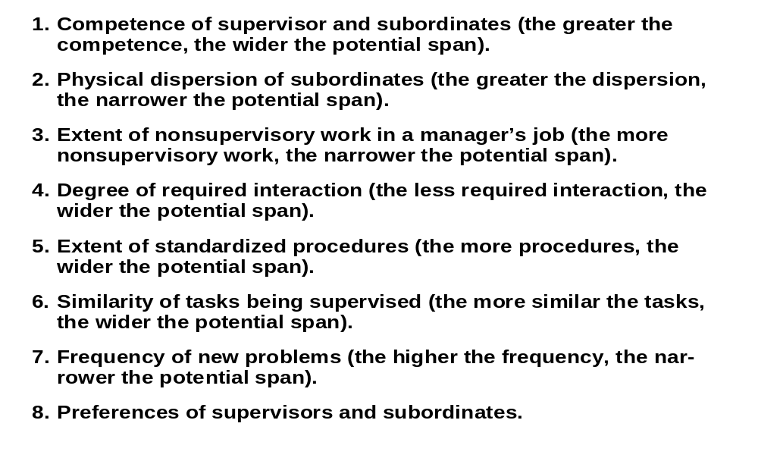
Determining the Appropriate Span:
Factors Influencing the Span of Management
Table 11.1
11–<number>

Slide 12
Tall Versus Flat Organizations
Tall Organization
President
Flat Organization
President
Figure 11.3
11–<number>

Slide 13
Establishing Reporting Relationships:
Tall versus Flat Organizations
Tall Organizations
  Are more expensive because of the number of managers involved.
  Foster more communication problems because of the number of people through whom information must pass.
Flat Organizations
  Lead to higher levels of employee morale and productivity.
  Create more administrative responsibility for the relatively few managers.
  Create more supervisory responsibility for managers due to wider spans of control.
11–<number>

Slide 14
Distributing Authority
Authority
  Power that has been legitimized by the organization.
Delegation
  The process by which managers assign a portion of their total workload to others.
Reasons for Delegation
  To enable the manager to get more work done by utilizing the skills and talents of subordinates.
  To foster the development of subordinates by having them participate in decision making and problem solving that allows them to learn about overall operations and improve their managerial skills.
11–<number>

Slide 15
Steps in the Delegation Process
Step 1
Step 2
Step 3
Assigning
responsibility
Granting
authority
Creating
accountability
Manager
Manager
Manager
Manager
Manager
Subordinate
Subordinate
Subordinate
Figure 11.4
11–<number>

Slide 16
Problems in Delegation
Manager
  Reluctant to delegate.
  Disorganization prevents planning work in advance.
  Subordinate’s success threatens superior’s advancement.
  Lack of trust in the subordinate to do well.
Subordinate
  Reluctant to accept delegation for fear of failure.
  Perceives no rewards for accepting additional responsibility.
  Prefers to avoid any risk and responsibility.
11–<number>

Slide 17
Decentralization and Centralization
Decentralization
  The process of systematically delegating power and authority throughout the organization to middle- and lower-level managers.
Centralization
  The process of systematically retaining power and authority in the hands of higher-level managers.
Factors Determining the Choice of Centralization
  The complexity and uncertainty of the external environment.
  The history of the organization.
  The nature (cost and risk) of the decisions to be made.
11–<number>

Slide 18


Coordinating Activities
Coordination
  The process of linking the activities of the various departments of the organization.
The Need for Coordination
  Departments and work groups are interdependent; the greater the interdependence, the greater the need for coordination.
11–<number>

Slide 19

Coordinating Activities:
Three Major Forms of Interdependence
Pooled interdependence
  When units operate with little interaction; their output is simply pooled at the organizational level.
Sequential interdependence
  When the output of one unit becomes the input of another unit in sequential fashion.
Reciprocal interdependence
  When activities flow both ways
  between units.
11–<number>

Slide 20
Three Major Forms of Interdependence
Sequential
Reciprocal
Input
Output
Input
Output
Input
Output
Pooled
Input
Input
Output
Input
Input
Output
11–<number>

Slide 21
Differentiating Between Positions
Line Positions
  Positions in the direct chain of command that are responsible for the achievement of an organization’s goals.
  Have formal (legitimate) authority to direct the workforce.
Staff Positions
  Positions intended to provide expertise, advice, and support to line positions.
  Have advisory authority; can give compulsory advice.
  Have functional authority to enforce compliance with organizational policies and procedures.
Administrative Intensity
  The degree to which managerial positions are concentrated in staff positions.
11–<number>

